Slide 1

BridgePrep Academy of Riverview
December Newsletter
6309 South US Highway 301
Riverview, FL 33568
(813) 405-1770
Dates to Remember
12/1: Middle School Lead Day
12/1-12/15: Toy Drive
12/2: Kindergarten STEM and Skate, Domi Ice, $2 dress down
12/3: 4th grade STEM and Skate
12/4: Yearbooks are on sale, the last day to purchase yearbooks for $35 is January 1st
12/6: 8th Grade STEM and Skate, early Release, School t-shirt with uniform bottoms
12/7: 1st grade STEM and Skate
12/8: 2nd Grade STEM and Skate, Middle School Lead Day
12/9: 3rd grade STEM and Skate, Domi Ice, $2 dress down
12/10: Limo Ride for cookie dough prize winners @10 am, Bulldog Bucks Store 6th-8th grade
12/13-12/17: Holiday Shop
12/13: 6th grade STEM and Skate, Regular Release, school T-shirt with uniform bottoms
12/14: 7th grade STEM and Skate, Bulldog Bucks Store 3rd-5th
12/15-12/17: Holiday Spirit Days
12/15: 5th grade STEM and Skate, Holiday socks and Headwear day, Bulldog Bucks Store K-2nd, Middle School Lead Day
12/16: SOTM breakfast, Holiday Twin Day, $2 dress down
12/17: Bulldog Social K-8, Ugly Sweater, Early Release
12/20-12/31: Winter Break
www.bridgeprepriverview.com/
Remember, daily attendance helps improve student grades and your students’ chance of success! Communicate with their teachers through Dojo, agenda, or a phone call to let them know if your child will be late or absent. Call the school as well because this helps us keep accurate attendance records.
A Note from Administration
Welcome back, BPA Riverview families!
Our theme this year is BPAR: We bring all minds to life! 🐾
As we enter the holiday season, we want to encourage you to find fun ways for your children to still learn while at home for extended breaks:
Scavenger Hunt-Have your child search for sight words or certain numbers around the house
Journal about Holiday celebrations/traditions. Younger students can draw, label and write a couple of sentences.
3. Try simple science “experiments” while cooking with an adult
4. Create a daily workout to their favorite music
5. Practice sorting with laundry and/or crayons, etc.
6. Create an art project
7. Play Bingo
8. Learn about how others celebrate this season
9. Practice budgeting while Holiday shopping
10. Choose Achieve3000 article that interests them
As always, we thank you for your support and patience as we all work to navigate our way through these difficult times.
Stay Healthy! Go Bulldogs!

Slide 2



Students of the Month
King- Amalia Rose Berrios
J. Rodriguez- Phillip Anthony
Vann-Tia Myers
Simon-Josiah Caraballo
Hazzard-Eliana Lowton
M. Rodriguez- Augusto Padilia
What are we
learning?
ELA: Review for MOY
Math: Review for MOY
Science: How things move

Slide 3


Students of the Month
What are we
learning?
Math
Represent and Solve Add To Problems
Represent and Solve Take From Problems
Represent and Solve Put Together/Take Apart Problems
Represent and Solve Comparison Problems
Science
Senses and Other Tools
What are Inquiry Skills?
How Do Scientists Work?
ELA and SS
Compare and Contrast Past and Present Events
Ciana Walker - Mrs. Figueroa
Mariam Leon - Ms. Miller
Michael Salas Ortiz - Mrs. Castro
Kendall Hogan - Ms. Staley
Alexis Astudillo - Ms. Osorio
Audrey Cox - Mrs. Santiago
Jayceon Gafford - Mrs. Sherman
Ramon Tavarez - Mrs. Rodriguez

Slide 4


Students of the Month
K. Figueroa-Leilanni Rodriguez
L. Ortiz- Adina Upkong
T. McGucken- Kiara Van-Solo
F. Taylor- Luis Gonzalez
C. Bridgewater- Tyler Cruz
S. Duncan - Tony Worrell
H. Valdez- Adrian Mack
What are we
learning?
ELA: Characters Perspective & Sequencing
Math: Place Value & Numbers to a thousand
Science: Scientific Method
Social Studies: Earth

Slide 5


Students of the Month
Anderson: Erykah Barnhill
Wilkey: Kamila Calix-Cruz
Cook: Josue Jaimes
Wilson: Anjali Mangal
Horne: Renessme Esteva
Ortiz: Nijah Williams
Tizzani: Aideliz Pabon Pagon
What are we
learning?
Reading: Main idea and text structures
Social Studies: US regional landmarks
Math: Multiplication
Science: Basic forms of energy

Slide 6


Students of the Month
Brown- Rayan Gamez
Hertogs- Mettlise Jones
Peterson- Alyssa Brinson
Tolland-Brooklyn Buckner-Aliane
Monteiro- Jack Bradley-Gumm
What are we
learning?
Math-using place value to divide multi digit numbers
Science- States of Matter
Social studies- St. Augustine
ELA-Text structures

Slide 7


Students of the Month
What are we
learning?
Math-dividing fractions and comparing & rounding decimals
Science-What is science? And types of investigations
Reading-Reading informational text
Social studies-financial literacy/Biz-Town
Writing-Informational writing
Bromen- De’Asia Timmons
Wynter- DreLeah Barton
Bumpus- Tatianna Therameau
Francois- Katherine Lantigua
DeTuro- Jordan Belvin
Rivera- David Jaimes

Slide 8


Students of the Month
Palmer- Ezarah Watson
Alvin- DiChelle Walker
Lewis- Maddison Boyd
Krupa- Jamilet Ortiz
Santana- Roselyn Guerrero Martinez
Coach Hernandez/Jackson- July Walton
What are we
learning?
Math: Unit Conversions
Science- Earthquakes and Volcanoes
ELA- Determining the point of view within a text; Identifying the parts of speech
Social Studies: Ancient Egypt and Kush
Journalism: Newspaper Anatomy
Computer Lab- ISIP, Achieve, Carnegie

Slide 9


Students of the Month
Krupa –
Classic Roberts
Santana - Payden Hawkins
Sica –
Tyler Albright
Wintrich - Alexisel Lopez
Coach Hernandez/Jackson- Jadon Aponte
What are we
learning?
Math:
Inequalities
Science- Bacteria and Viruses
ELA- Author's Purpose and Parts of Speech
Civics: Florida and United States Constitutions
Journalism: Newspaper Anatomy
Computer Lab- ISIP, Achieve, Carnegie

Slide 10


Students of the Month
Buenviaje-Duddy- Jeslyn Perez
Johnson- Alliyana Cabral
Claessen- Erick Vargas
McCaleb- Latoya John
Santana- Juvandy Robinson
Colquitt- Alex Lopez Ortiz
What are we
learning?
Science: Atoms and the Periodic Table
History: The Constitution
Math: Graphing Linear Systems
Intensive reading: Main Idea
ELA: Analyzing Figurative Language
Journalism: Newspaper Anatomy

Slide 11




Elementary PE Teacher:
Coach Torres
De’Montay Thomas (Bumpus HR) 5th grade
Introducing specifics sport skills
Coach Moore
SOM: ​Sofia Ventura from Mr. Monteiro 4th grade
Focus: Hand eye coordination
Coach McFarland
SOM -Amelia Ritchie
K-J Rodriguez
Focus- Striking with short-handed implements
Middle PE Teacher:
Coach Carrera:
Cooperative Games
Maleah Allen
Jovanny Emmanuelly
Coach Hernandez:
Cooperative Games
Jacob Emmanuelli

Slide 12





Elementary Spanish Teachers:
O'Neill (K)
Write short sentences using adjectives
Orlando Reyes
Arroyo (1st):
Winter elements – Christmas
Kriysan M. Rigg
S. Diaz (2nd):
Verbs- Winter Elements/ Compare & Contrast
Jeison Carrillo
Jimenez (3):
Ages of change-compare & contrast
Atur Pinol
V. Diaz (4th):
Christmas around the world-details & verbs
Brooklyn M. Buckner
VIANNI (5th)
Christmas around the world-verbs-main idea
Tatiana Therameau
Spanish Middle School Teachers:
Cuellar – Christmas Celebration
Serenity Williams
Edanna Acosta
Roque– Pastimes and Sports
Jae’Onni Harris

Slide 13







Art Teachers:
Mrs. Jenkins
Student of the Month:
Meleah Santana (Hertogs 4th Gr.)
Focus:
Kinder: Letter Art/ O- Ornament
1st: Snow Globes
2nd: Gingerbread House
3rd: Snowflakes for Holiday display
4th: Still Life with Fruit
5th: Continue Agamographs
Music Teacher:
Cline (Elementary):
Khayden Williams
Introduction to percussion techniques and instruments with emphasis on the piano.
Reading and Math Interventions
Teachers:
V. Zamora, M. Quinonez

Slide 14
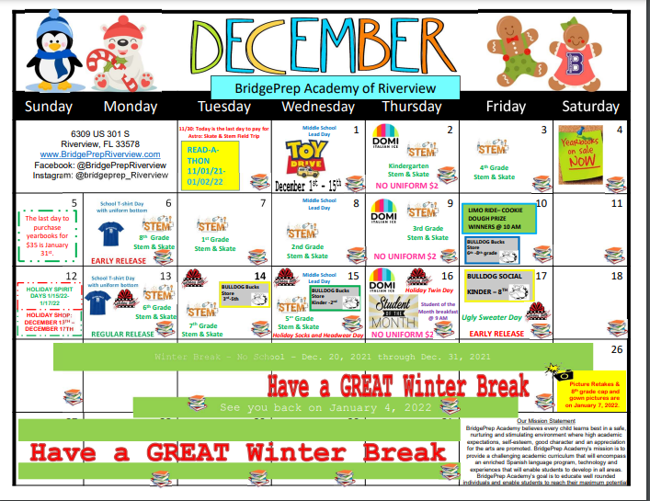
December Calendar

Slide 15




Check out our website and social media for updates!
http://bariverview.bridgeprepacademy.com/
http://facebook.com/bridgeprepacademyofriverview
@bridgeprep_riverview
bpariverview

