Slide 1

BridgePrep Academy of Riverview
February Newsletter
6309 South US Highway 301
Riverview, FL 33568
(813) 405-1770
Dates to Remember
2/8: School t-shirt with uniform bottoms; K-5 report cards online
2/10: Middle School Lead Day
2/11: Domi Ice (3$); No uniform day ($2)
2/12: NO SCHOOL
2/15: NO SCHOOL
2/16: Honor Roll: K-8
2/17: Middle School Lead Day
2/18: Domi Ice, No uniform
2/19: Black History Month Program K-8
2/22: School t-shirt with uniform bottoms
2/23: Student of the Month
2/24: Middle School Lead Day
2/25: Domi Ice, No uniform day
2/26: Black History Month Gallery Walk
Purchase your agendas, Spirit Wear, and more from our online store!
www.bridgeprepriverview.com/
Remember, daily attendance helps improve student grades and your students’ chance of success! Communicate with their teachers through Dojo, agenda, or a phone call to let them know if your child will be late or absent. Call the school as well because this helps us keep accurate attendance records.
Make attendance a Dream you Believe you can Achieve!
A Note from Administration
Welcome back, BPA Riverview families! As we begin our DREAM this year, and believe in it, all things become ACHIEVEABLE! Here are a few things you should know thus far:
Our theme this year is Dream It, Believe It, Achieve It and our teachers have a few dreams for the school year that they believe they can achieve! 🐾
In-Person Learning vs Remote Learning vs Hybrid.
At the end of March 2020 (Spring Break to be exact), our lives were thrown into gigantic chasm of confusion. Every school went on lockdown and we were all forced into making online learning a reality. We rushed to get systems in place so that we could adequately teach our students; downloaded multiple programs to ensure success as best as we could; and moved our learning to an unprecedented new way of teaching and learning.
As we near almost one year later, many of our Bulldogs continue to use the online learning method. Our teachers conduct simultaneous classes with students in the building as well as on the Zoom platform. Some students returned in a hybrid capacity- a few days in building, a few days at home.
But you may be asking yourself, "what do I do if I feel my child may progress better in-person full time or on a hybrid system if online doesn't seem to be working for us?"
The easiest answer for this is to reach out to your child's teacher. Have a good and open-minded conversation with them about your concerns. This doesn't have to be a lengthy conversation; simply Dojo'ing them your questions or concerns works as well. Give them time to answer you and be ready for the suggestion of “Have you considered putting them back in the building full time or on a hybrid system?"
We all understand why you may be keeping them home. However, if your child's teacher suggests bringing them back full time or on a hybrid system, give this some strong consideration. Your child may not be in the building as they might have been before this pandemic, but your child's teacher does know, see, hear, comfort, and guide them. Our teachers use multiple methods to assess a student's needs. They truly care about your children and want only the best.
Here are some simple definitions/explanations of each method so that you can make an informed decision about which method is best for your student.
In-Person: Full time, in the building. The advantage here is that your child can receive immediate learning assistance; whether that is provided by the teacher or the teacher and our interventionists (reading, ESE, ESOL, etc.) With online or hybrid mode, this will be challenging.
Online: Full time, at home on the computer all day; for every class, your child is assigned to. This method is more involved as it does require the parent become something like an aide to the teacher. You would need to keep track of your child's work-making sure it gets uploaded to EdNet on time; ensure your child is ready every morning with any work the teacher uploaded to EdNet; and ensure your child remains online for the duration of the day for each of their classes.
Hybrid: This is a combination of both previous methods. You choose the days you wish your child to attend (but they should remain consistent). However, this also requires a level of organization on your part. They must carry all books back and forth from school to home. They will also need to upload their work to EdNet on days they are not in building. And many of the requirements for online also apply to hybrid.
If you have any doubts about your child's progress and feel they would do better in person, notify your child's teacher. In most cases, your child can return immediately to in person learning.
This isn't about having students in seats with a physical presence, this is about making sure your children and our students- receive the best possible education we can give them.

Slide 2



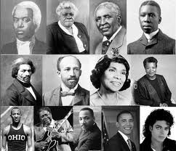

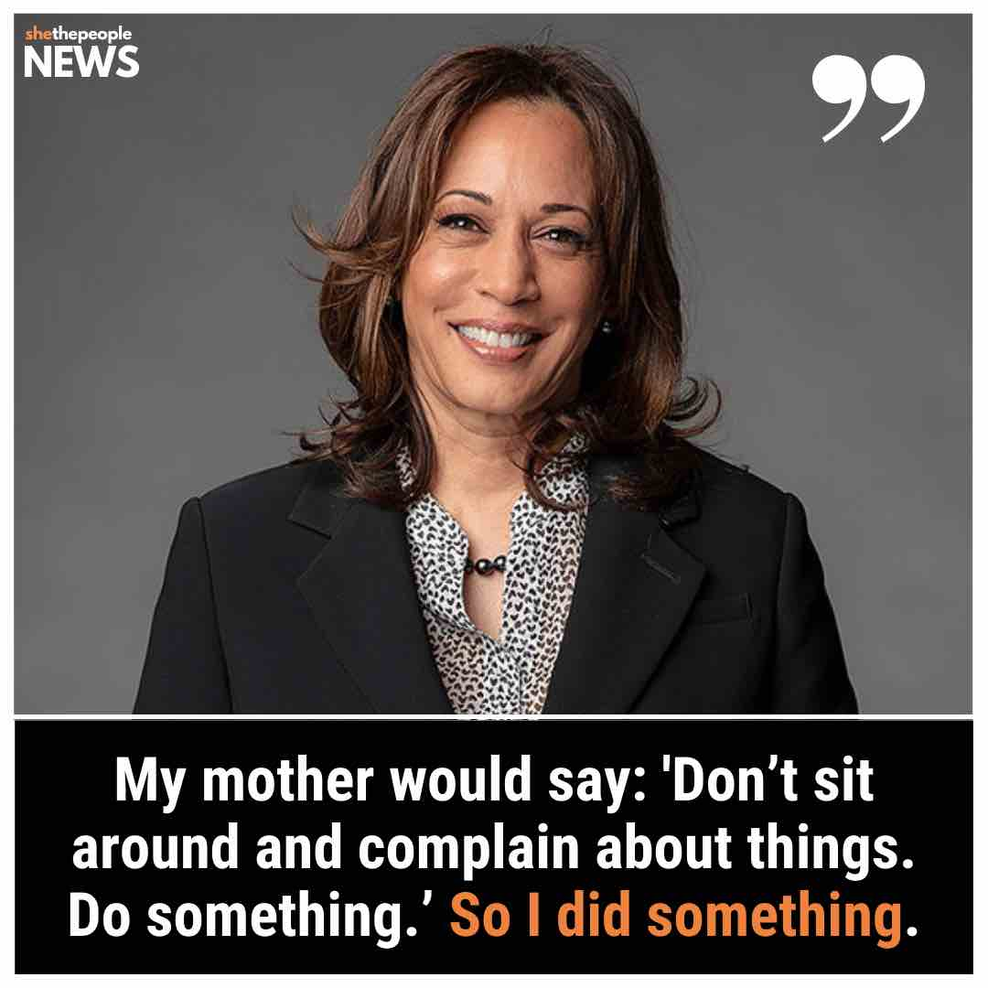



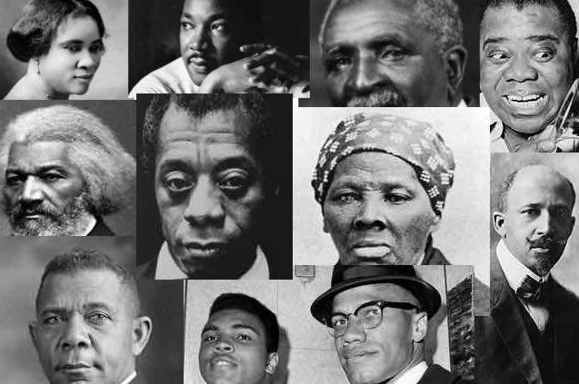

CELEBRATING BLACK HISTORY MONTH
https://www.africanamericanhistorymonth.gov/
https://asalh.org/about-us/origins-of-black-history-month/
https://www.oprahmag.com/life/g25954127/african-american-historical-figures/
https://www.oprahmag.com/life/a35181062/black-history-facts/
https://www.tuskegee.edu/support-tu/tuskegee-airmen

Slide 3



Students of the Month
Miller- Julie Parrado
Flowers- Alrletty Alonso-Marti
Vann- Lewis Hernandez
Simon- Audrey Cox
Figueroa- Valentina Lozano
Lyons- DeMarcus Evans
Jiminez- Makenzie Shepherd
King- Ivy Rose
What are we
learning?
ELA: Identify key details (characters, setting, events); Compare and contrast
Math: Addition
Science: Matter
Social Studies: Showing Respect; Good Citizen; Black History

Slide 4

Students of the Month
Sherman – Neyden Alamo
Rodriguez – Adriel Cruz
Osorio – William Courtney
Staley – Cadence Lewis
Santiago – Jaurice Fennell
McGucken – Kyrie Johnson
Wilson- Leriann Vargas-Garcia
What are we
learning?
Math - Subtractions Strategies
Science – Natural Resources
Social Studies - Goods and Services, Black History Month
ELA- Main Idea, Sequencing, Sentence building, Mechanics of Grammar

Slide 5

Students of the Month
Figueroa- Ismerai Ruiz
Ortiz- Benjamin Landis
Rodriguez-Maria Bozo
Morales- Amaya L. Medina
Duncan- Kenneth Balkman
Bridgewater- Hannah Walker
What are we
learning?
Math: Two digit
subtraction
Science: Weather
Social Studies: Culture
ELA: Analyzing informational text to identify main purpose and reason

Slide 6

Students of the Month
Anderson: Jaser Martinez
Cook: Liam Rivera-Rodriguez
Dodson: Bryson Harris
Garcia: Axel Candelario
Lewis: Neivah Germain
What are we
learning?
Math- Learning strategies that support division
ELA- Word Choice within their writing. Formal Writing Process. Identifying theme of a story based on the character's actions and making predictions
Science- Gravity and its attributes
Social Studies- Contributions of African Americans and the Black Culture to determine impact on America
Online Tools: Achieve 3000, two articles per week and 4 green lights using Reflex Math

Slide 7

Students of the Month
Wilkey- Zuleyni Oliveras-Cruz
Brown- Jelena Suarez-Caceras
Malinowski- Camila Machado
Monteiro- David King
Peterson- Jamuel Ruiz-Arroyo
What are we
learning?
ELA- Writing a 5-paragraph informative/opinion essay.
Math- adding/subtracting; multiplying
Science- Earth's movement in space; the Moon and Stars
Social Studies- Black History Month Projects

Slide 8

Students of the Month
Bromen-Johann Sanchez Martinez
Wynter-Eleanna Mattocks
Bumpus Johnson-Roniyah Canady
Floriano-Nandini Sirimulla
What are we
learning?
Math-Multiplying and dividing decimals
ELA-nonfiction text structure, explaining an author's point of view using reason and details and writing opinion and informative essays
Social Studies-JA BizTown
Science-Space Science & Earth’s Systems

Slide 9

Students of the Month
Colquitt/Deturo- Charity Williams-Jordan
Alvin-Seriyah Joyner-Torres
Palmer-Abigail Johnson
Rivera-Eleanor Lee
What are we
learning?
Math:
Converting Units
Science-Effects of weather and climate on Earth
ELA- Character Development and Essay Writing
Social Studies: The Israelites and achievements of People of Color
Intensive Reading: Real World Connections

Slide 10

Students of the Month
Gunn: Alicia Erving
Krupa: Alejandra Gonzalez
Sica: Savannah Lussier
Wisely: Samaria Devoe
What are we
learning?
Math: Order of
Operations
Science: Energy transfer in the food web
ELA: Settings, Characters, Character Traits, and their interactions
Civics: Sources and types of laws. Levels and functions of courts, landmark cases
Intensive Reading: Advantage and disadvantage of using different mediums

Slide 11

Students of the Month
Buenviaje-Duddy- Az'hera Davis
Johnson- Ja'Kyla Mendoza
Chandler- Zyquan Daniels
McCaleb- Caden Williams
What are we
learning?
Science: Newton's Laws of Motion
History: Black History
Math: Systems of Equations
Intensive reading: FSA Prep and Black History Literature
ELA: Poetry and Black History Literature

Slide 12



Elementary PE Teacher:
Coach McFarland: Volleyball
Richard Canpanelli
Coach Torres: Volleyball
Lillyen Stahl
Middle PE Teacher:
Coach Lebrun: Soccer
Encarnacion Feliz
Coach Hernandez: Track and Field
Jeslyn Perez
Coach Stallworth: Mechanical Principles in Soccer
Megane Chavannes

Slide 13




Elementary Spanish Teachers:
O'Neill (K): Sílbas pa,ape,pi,po,pu/vocal E
Brooklyn M. Farris
Arroyo (1st): Vowels and alphabet (vocabulary on the parts of a house)
Josuan Melendez
S. Diaz (1st/2nd): The vowels, alphabet and monosillabus ma,me,mi,mo,mu
Aleanyx Feliciano
Prado (3): Nouns and adjectives-Definitions and characteristics
Haley Segura Sandoval
V. Diaz (4th): Professions, Reading Comprehension
Jeriel Montes
Viani (5): Daily Routines, parts of the house, different furniture of the house.
Jason Patino
Spanish Middle School Teachers:
Cuellar – Jadried Perez
Grammar Structure (verbs, articles, prepositions and adjectives; The City addresses its description
Roque – Daily Routines and demonstrative
adjectives
Jeffrey Presley
Rodriguez- Grammar
Ashlynn Knighten

Slide 14






Art Teachers:
Jenkins: Annual Doodle for Google Contest
Krystal Mujica Reyes
Kirkland: Black History Month
Zaniyah Zayas
Music Teacher: Cline (Elementary)
Joshua Vazquez
Sight Reading Rhythm Notation for Half Notes (To-e), Quarter Notes (Ta), Eighth Notes (Ti-Ti), and Quarter Rests (Shh).
Ortiz (Middle School): America's Music
Gabriella Lowman
Reading and Math Interventions
Implements one on one or small group Tier 3 instruction focused on a small but targeted set of reading and math skills.
Teachers: V. Zamora, A. Ramirez, M. Quinonez

Slide 15




Slide 16




Check out our website and social media for updates!
http://bariverview.bridgeprepacademy.com/
http://facebook.com/bridgeprepacademyofriverview
@bridgeprep_riverview
bpariverview

